Slide 1
6. Video coding (Part 2)
⎯MPEG-1
Yi-Shin Tung
National Taiwan University

Slide 2
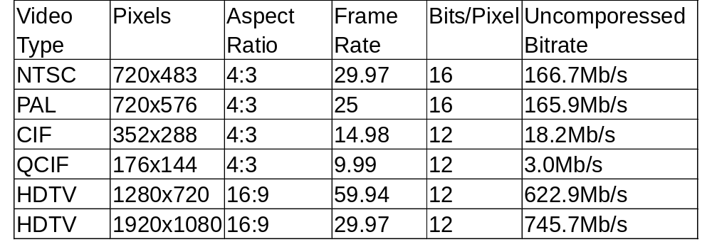
Digital video compression
People uses baseline JPEG to compress real-time video (motion JPEG, MJPEG).
  Adv: Symmetric, random access
  Disadv: compression performance
Modern compression technology leads to compression rates of over 100-to-1.
Master a video once and play it back many times. (100x computing power of the decoding process)

Slide 3
Key factors for MPEG video quality
Application definition
  The resolution of the original video source
  The bitrate of the transmission channel
  The adopted coding standards
Encoding technology maturity
  Motion estimator effectiveness
  Mode decision effectiveness
  Region of interest (ROI)

Slide 4
Applications
Video teleconferencing
  ITU-T H.261 for ISDN videoconferencing,
  ITU-T H.263 for POTS videoconferencing, and
  ITU-T H.262 for ATM/broadband videoconferencing.
Storing movies on CD-ROM
  ISO MPEG-1: 1.2Mb/s for video coding and 256kb/s for audio coding.
Broadcast and storing video on DVD
  ISO MPEG-2: 2-15Mb/s for video and audio coding
Low-Bit-Rate video telephony over POTS
  ITU-T H.324: 10Kb/s for video and as little as 5.3kb/s for audio coding

Slide 5
Applications
Separate audio-visual objects
  MPEG-4: Scene description language, coding for both natural and synthetic.
Coding of multimedia Metadata
  MPEG-7: data describing the features of the multimedia data.
Using MPEG-2 for advanced HDTV
  15-400Mb/s for video coding.

Slide 6
MPEG: accomplishment
MPEG-1: error free environments
MPEG-2: broadcast TV
MPEG-4: object based coding
MPEG-7: multimedia description
MPEG-21: seven element initiative for multimedia deployment, multimedia framework

Slide 7
MPEG: a new look
MPEG-A: Multimedia application format
  Music player application, photo player application
MPEG-B: MPEG systems technology
  Binary format for XML
MPEG-C: MPEG video technology
MPEG-D: MPEG audio technology
MPEG-E: MPEG multimedia middleware
MPEG-H: next generation video applications
U3D: Universal 3D file format

Slide 8
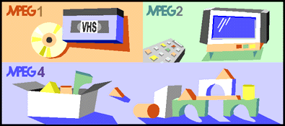
A Success Story: MPEG
Why MPEG succeeds?
  The concept of unique, application-independent, audio-visual information representation.
  Whoever made an investment to develop hardware or software implementing an MPEG standard knew that multiple client industries existed for his product.
Three types of applications
  Storing-video
  Broadcast video
  Video conferencing

Slide 9
The MPEG Approach to Standardization
Stick to the deadline
A-priori standardization
Not systems but tools
Specify the minimum
One functionality - one tool
Relocation of tools
Verification of standard

Slide 10
MPEG Style
In the standard text, specify
  Video stream syntax
  Semantics for the syntax elements
  Decoding process
Did not describe encoding process and algorithm inside the text, but put them in the test/reference model.
  MPEG-2, test model
  MPEG-4, verification model
  AVC, joint model

Slide 11
MPEG-1

Slide 12
Applications and requirements
Applications
  Video on digital storage media, CD-ROM (VCD).
Requirements
  Coding efficiency (best quality given a certain bitrate)
  Random access to a segment or a frame.
  Trick modes such as fast forward and fast reverse.
  Tradeoff between video quality and coding/decoding delay.
  Edit compressed bitstreams while keep decodability.
  Support a variety of video formats and image sizes.

Slide 13
Organization
ISO
IEC
International
Organization for
Standardization
International
Electrotechnical
Commission
ISO/IEC JTC1
ISO/IEC Joint Technical Committee
SC1
SC :Sub Committee
WG :Working Group
JPEG :Joint Photographic
Coding Experts Group
MHEG :Multimedia and Hypermedia
Information Coding Experts Group
MPEG :Moving Picture Experts Group
SC2
WG1(JPEG, JBIG)
SC29
WG11(MPEG)
Multimedia
Coding Area
WG12(MHEG)

Slide 14
ISO/IEC 11172
Information technology – Coding of moving pictures and associated audio for digital storage media at up to about 1.5 Mbit/s
  Part 1: Systems
  Part 2: Video
  Part 3: Audio
  Part 4: Compliance testing
  Part 5: Simulation Software
The official page: http://cselt.it/mpeg

Slide 15
Features
MPEG/H.26x series standard
  Did not specify the encoding method.
  Specify the decoding process
    Specify the video bit stream.
    Specify the decoding semantics.
Many “First” innovations
  First integrated audio-visual coding standard
  First signal processing standard developed using software and described using "C“.
  First video coding standard independent of video format
    “bitrate”, “frame rate”, “no. of lines”, “no. of pixels/line”, etc. are “parameters”, whose overriding importance in the analog domain was reduced to size in the digital domain.

Slide 16
Reference Decoding Model for MPEG-1
Source
Video
Demultiplexer
Delivery
Audio

Slide 17
Coding Mechanism
Coding methods in MPEG-1 Standard
  Color Space Conversion (lossy ,T.C)
  Motion Estimation/Compensation (lossless, P.C)
  DCT (lossless, T.C)
  Quantization (lossy, perceptual coding)
  VLC (lossless, E.C)
  DPCM in DC (lossless, P.C)
  Zigzag Scan (lossless, T.C)

Slide 18

MPEG-1 Encoding Flowchart
Encoder procedures are not specified by the standard. Different algorithms may apply
  Motion estimation, mode/quantizer decision.
R
G
B
To Other
Color Space
(Optional)
DPCM
Huffman or
Arithmetic
Coding
Scan
I-Frame
DCT
Quant
Zig-Zag
Y
RLE
I
Q
01001...
IQuant
P B-Frame
Different Image
Motion
Estatimation
Motion
Vector
IDCT
Y
Reconstruct &
Update
I
Q
Forward Frame Buffer
Y
I
Q
Backward Frame Buffer

Slide 19
Motion Compensation
Using motion vector between current frame and reference frame to reconstruct the prediction of current frame in the MB basis.
16x16 pels is used for luma as a basic block, while 8x8 is for chroma.
Current frame
Reconstruct frame
Reference frame

Slide 20
Fractional motion compensation
Motion compensation
  16x16 luma pels as a basic block.
  Half-pel motion is allowed. Bilinear interpolation filter is applied.
PMV is computed, and the difference (MV−PMV) is encoded.
The pel prediction error is coded using DCT-based intra-frame encoding.
A
B
a = A
a
b
b = (A+B+1)/2
c
d
c = (A+C+1)/2
d = (A+B+C+D+2)/4
C
D

Slide 21
Motion Estimation
Motion Estimation
Motion Vector
Frame N
Frame N+1
88 84 83 84 85 86 83 82 86 82 82 83 82 83 83 81 82 82 84 87 87 87 81 84 81 86 87 89 82 82 84 87 81 84 83 87 85 89 80 81 81 85 85 86 81 89 81 85 82 81 86 83 86 89 81 84 88 88 90 84 85 88 88 81
84 82 83 81 85 86 83 81 82 82 81 83 82 83 83 81 83 82 84 87 87 87 81 88 81 85 86 88 82 82 84 87 81 84 85 87 85 89 84 81 82 85 81 84 81 89 81 83 81 87 86 83 86 89 81 84 88 82 87 84 87 89 84 81
-4 -2 0 -3 0 0 0 -1 -4 0 -1 0 0 0 0 0 1 0 0 0 0 0 0 4 0 -1 -1 -1 0 0 0 0 0 0 2 0 0 0 4 0 1 0 -4 -2 0 0 0 -2 -1 6 0 0 0 0 0 0 0 -6 -3 0 2 1 -4 0
-
=

Slide 22
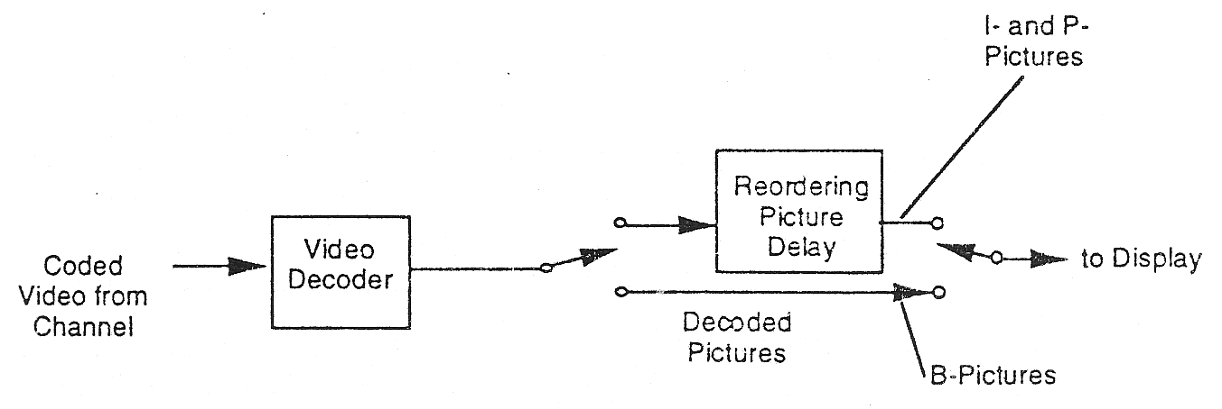
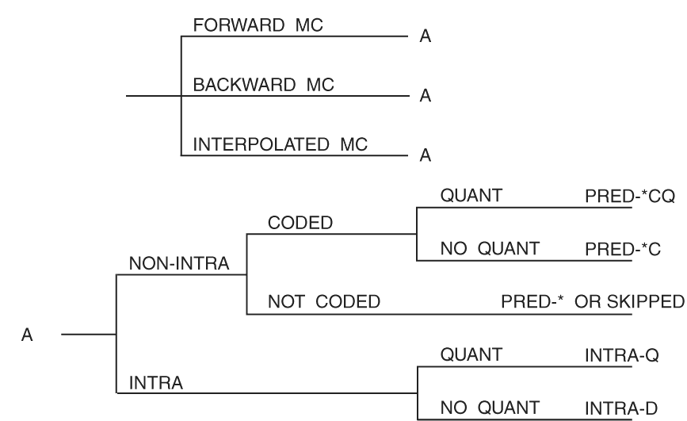
B-Frame
The non-referable B-picture is introduced for increasing the frame rate without increasing too much bitrate.
Bilinear filter is used for generating the predictor from forward and backward predictors.
An additional frame buffer is required.
Forward
prediction
Backward
prediction
I or P
B
I or P

Slide 23
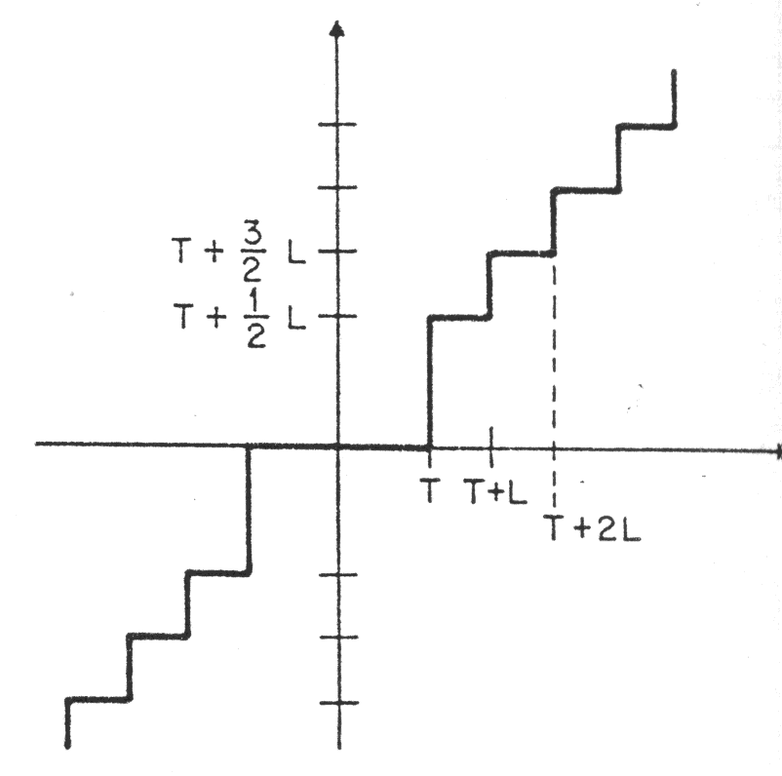
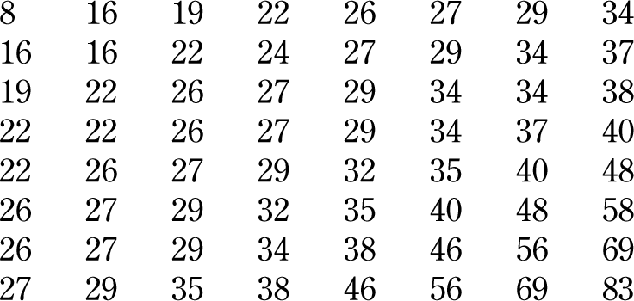
Quantization
Default quantization matrices (intra and inter)
  Can be overwritten.
Dead-zone design: Trade-off between bitrate and quality.
Quantizer scale (qp) adjustable in the MB layer
DC quantization: fixed quantizer
Intra AC quantization: no dead-zone
Inter AC quantization: dead-zone is used.
Default intra quant table

Slide 24
Modularized MPEG-1/2 decoding process
Configuration data
syntax
vlc table
Parsing & Decoding FUs
bitstream
SYNP
FU
VLD FU
RLD FU
MBG FU
MB data
CS
Global
Control
Unit
CI
Recons.
frame
VR
FU
FFR
FU
IT
FU
IQ
FU
IS
FU
DCR
FU
MC
FU
MVR
FU
Macroblock based FUs

Slide 25
Bitstream Structure
All headers start with a value of 000001XX_{H}.
  Sequence Layer
  Group of picture (GOP) Layer
  Picture Layer
  Slice Layer
  Macroblock Layer (no header)
  Block (no header)
Marker bit
  Prevent start-code emulation
  Can be used for error detection

Slide 26
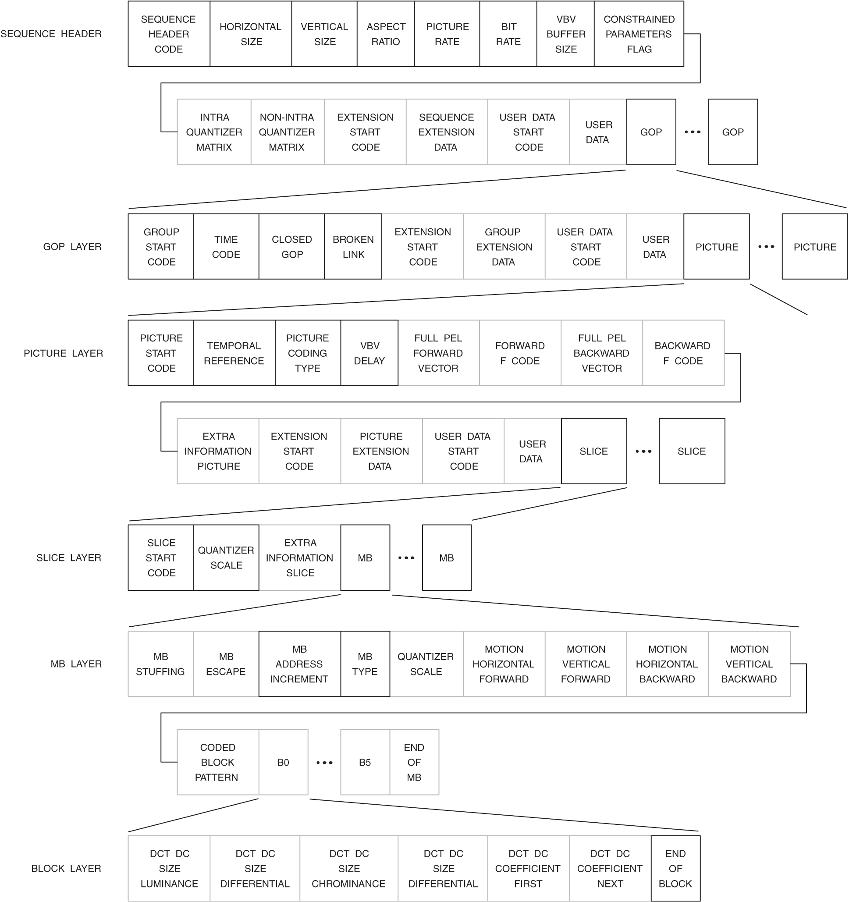

Slide 27

Sequence Layer
Information in the Sequence Header
  horizontal and vertical size
  aspect ratio
  frame rate
  bit-rate (in unit of 400 bps. Max value stands for VBR.)
  buffer size in the unit of 16Kbits
  Constrained Parameter Set Flag
compressed
video data
from channel
to
decoder
buffer
CBR: input data rate is the same
VBR: input data rate is varying
At each picture time, the data
for one picture is removed
instantaneously for decoding

Slide 28
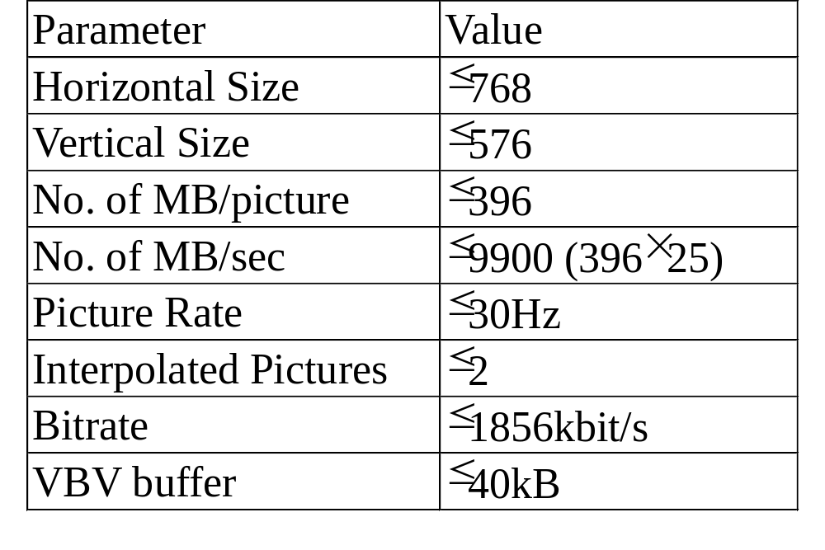
Constrained Parameter Set (CPS)
Most people thought MPEG-1 as CPS MPEG-1.
  A subset of MPEG-1 for interoperability.

Slide 29
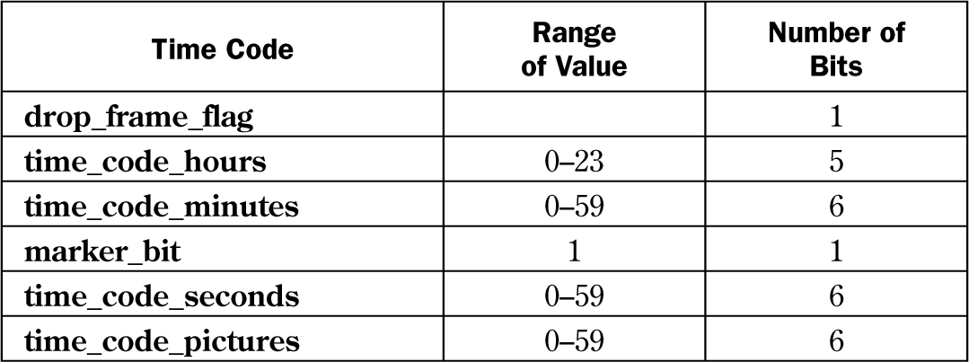
GOP Layer
I,P,B three types of picture to consist a GOP
Time code
Closed GOP
  no B-frame refer to the last P-frame in the previous GOP
Broken GOP
  The previous GOP is missing, and few leading B-frames cannot be decoded correctly.
Typically ½ sec for a GOP
Playback control (fast playback, pause mode, reverse playback)

Slide 30


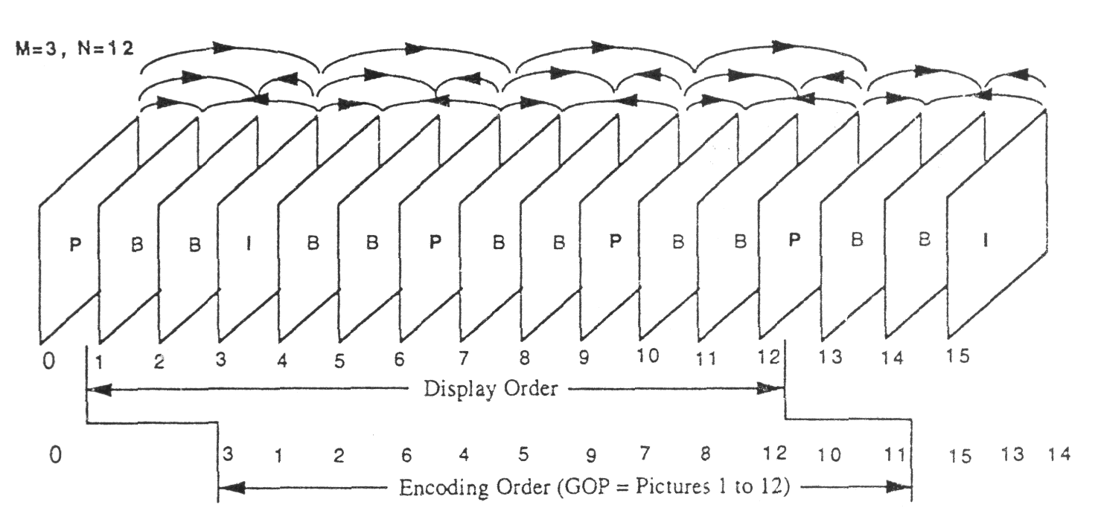
Picture Layer
Information in the Picture Header
  Temporal Reference (10bit)
  Picture coding type (I frame, P frame, B frame, D frame)
  vbv_delay
  Full-pel motion vector, f_code (mv_range)
Big-picture exception in the low-delay mode

Slide 31
GOB Layer (Slice)
Information in GOB header
  Slice_vertical_position, (00000101~000001AF_{H})
  Quantizer scale (5 bit)
Macroblock Line (Group Of Block)
Convenient to perform error concealment when transmission error occurs.
GOB size is decided according to channel error probability.
Restricted slice structure or general slice structure

Slide 32
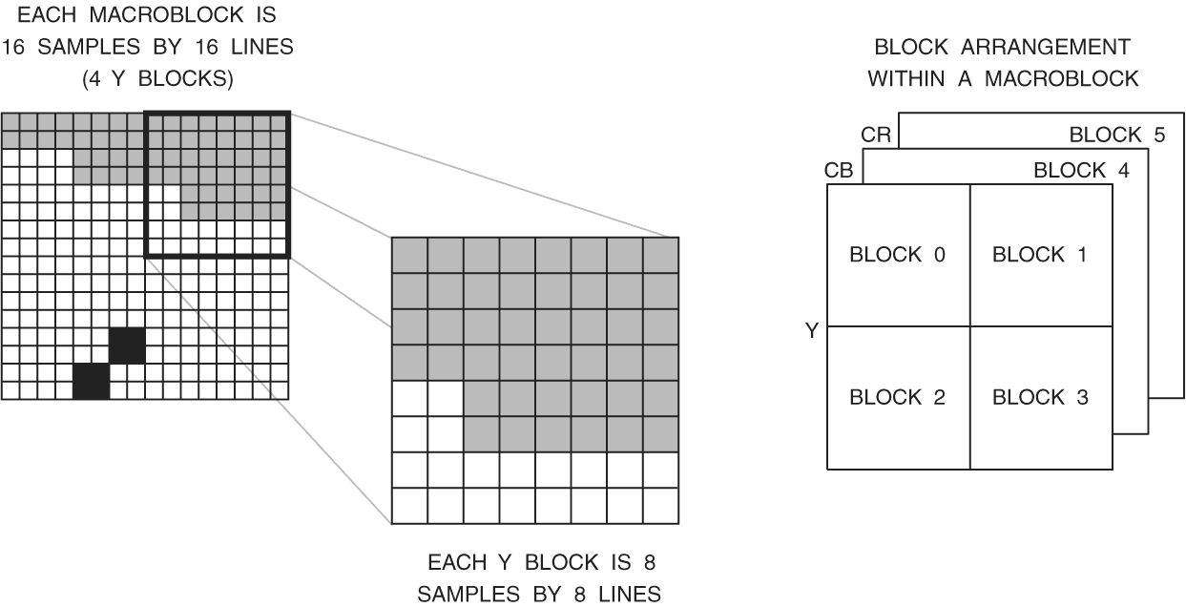
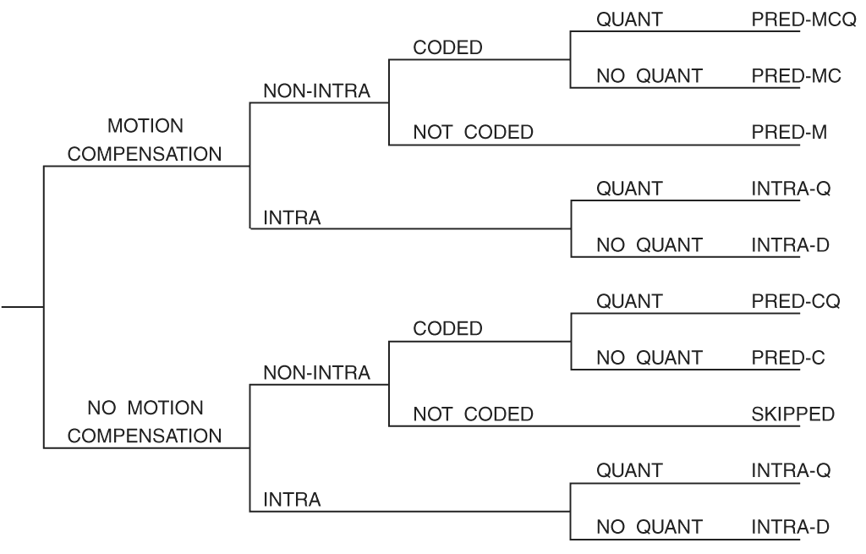
Macroblock Layer
An MB has
  16x16 luminance pels
  8x8 chrominance pels
  basic unit for Motion Estimation
Information in MB header
  Address increment
  MB type (I: 2, P: 8, B:12)
  quantizer if provided
  Forward/backward
  motion if provided
  cbp if provided
Skip MB needs fewer bits.
  P: predicted MB with zero mv
  B: MB type as previous MB
P macroblock type

Slide 33
Block Layer
Block: 8 pixels by 8 lines
  basic unit for DCT
DC coding (dc_size + dc_diff)
2D run level coding
  dct_coeff_first
  dct_coeff_next
  escape code followed by FLC
  end_of_block
Quantization with dead-zone

Slide 34
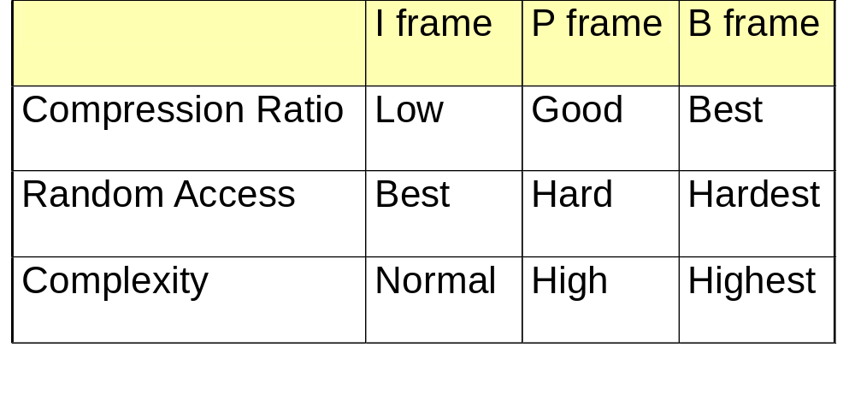
I,P,B Frame
Differences between picture types

Slide 35
D frame (DC-only frame)
Only DC components of DCT coefficients are coded.
Frames coded as a stand-alone still image.
D frames are rarely used in the existing MPEG-1 videos.
For browsing and database applications.

Slide 36
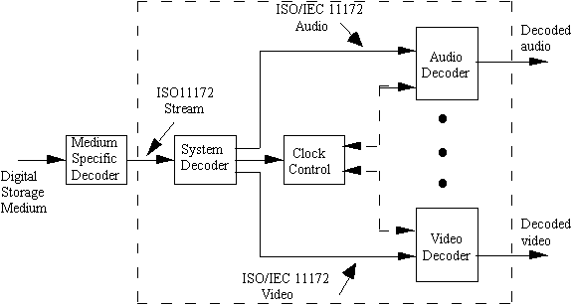
MPEG-1 System Decoder
Video is finally up-sampled to NTSC/PAL

Slide 37
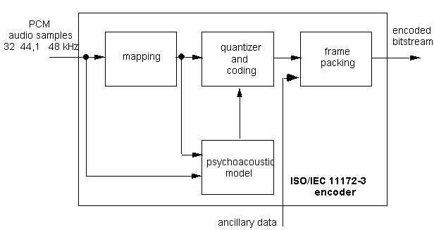
11172-3
Specify coded representation of compressed audio both mono and stereo.
Support three layers
Applications
  Radio broadcasting at CD quality
  Music distribution on the Web

Slide 38
Compliance Testing (Part 4)
Tests to verify whether bitstreams and decoders meet the standard.
  Manufacturers of encoders to verify the valid bitstreams.
  Manufacturers of decoders to verify if the decoder meets the standard requirements for claimed decoder capabilities.
  Applications to verify whether the characteristics of the bitstream meet the application requirements.

Slide 39
Software Simulation (Part 5)
Include
  A complete software implementation of the standard decoder
  An example software encoder
Influence the development of the MMX.
  Supports typical computation-intensive video-coding operation.

Slide 40
Reading assignment
Mandatory
  Digital Video: An Introduction to MPEG-2,
    Chapter 7 “motion compensation modes in MPEG” and
    Chapter 8 “MPEG-2 video coding and compression”.
Optional
  Video Demystified, Chapter 12 “MPEG-1”

Slide 41
Homework
4. Study the fields, vbv_buffer_size and vbv_delay, for CBR/VBR video sequences.
  Describe the buffer handling mechanism for seeking and tricky mode.
  Write a program for analyzing the existing MPEG-1(MPEG-2) video for reporting vbv conformance, minimal vbv buffer requirement.

